Slide 1
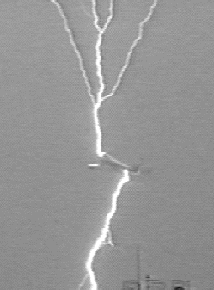
Intensification of ambient electric fields by (1) conducting cylinders (2) surface charges on insulating planes. John J Lowke, Eugene Tam and Anthony Murphy. CSIRO Manufacturing, Lindfield, Sydney NSW
Aircraft
Hail
Mice

Slide 2
Ambient Electric Field = E₀
E = Q/4πε₀R²
V = Q/4πε₀R
Total Potential = E₀L - Q/4πε₀R = 0
Q = 4πε₀R E₀L
Electric Field = Q/4πε₀R²
= E₀L/R
Ambient Potential
Q _
_
Total Potential
Potential from Charges
V = E₀L
V = 0
L
V = 0
V = 0

Slide 4
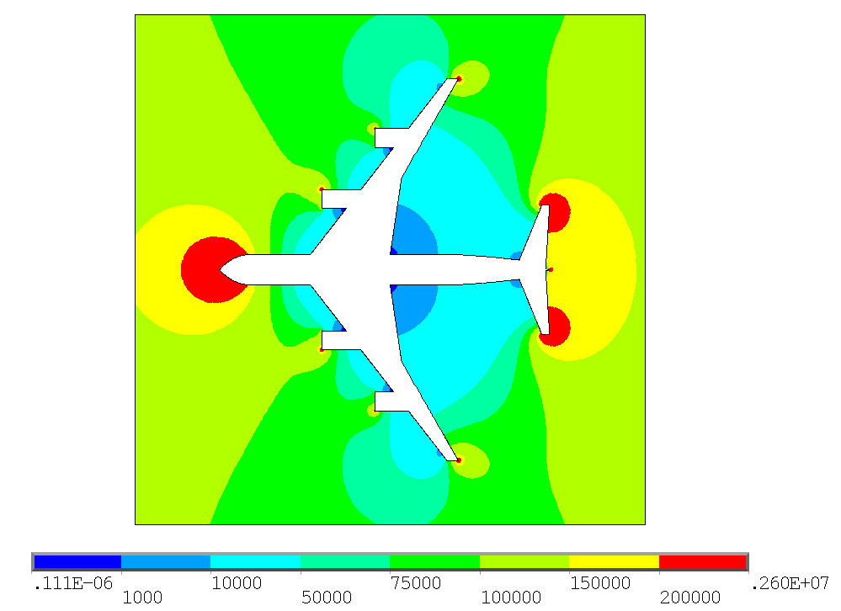
From C. Karch et al, Deutscher Luft und
Raumfahrtkongress 2012 Doc 450139
Background Field 0.1 MV/m
Fields accentuated to 2.6 MV/m
For Airbus fuselage

Slide 5
Lightning initiated by aircraft

Slide 6
Hail
“Prediction of Lightning Inception”
Phys Rev Letters 115, 015002, 2015
Ete Ebert et al
The Physics and Chemistry of Clouds.
D Lamb and J Verlinde

Slide 8
Charges collected on Insulating Windows
amplify background fields
e
e
e
Field E
Field E
Field zero
Field 2E

Slide 9
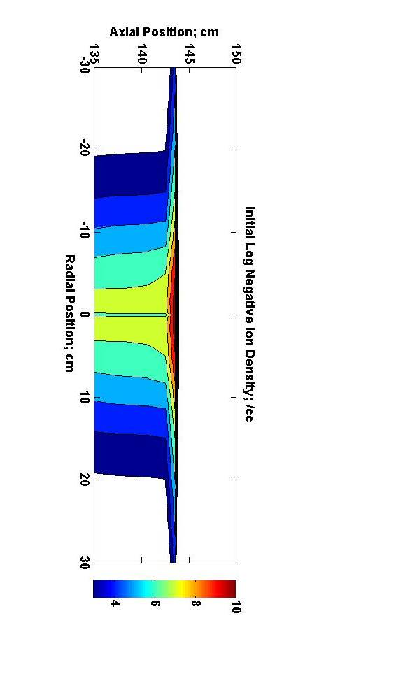
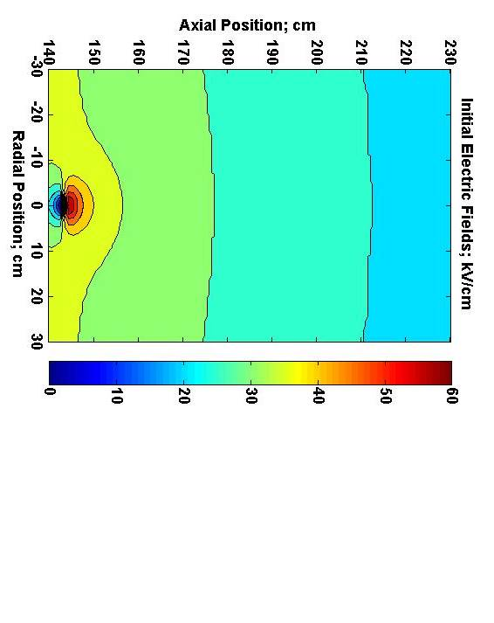
Charges collected on surfaces can
double background fields
Log Charge Densities; /cc Electric fields; kV/cm

Slide 10
Tumors in 5 mice
E Szili, Plasma Sources Sci. Technol. 27 (2018) 01400

Slide 11
Ionization and Attachment Coefficients in Air at 1 bar.

Slide 12
Equilibrium Particle Densities
electrons, positive ions, negative ions and singlet delta metastable molecules

Slide 13
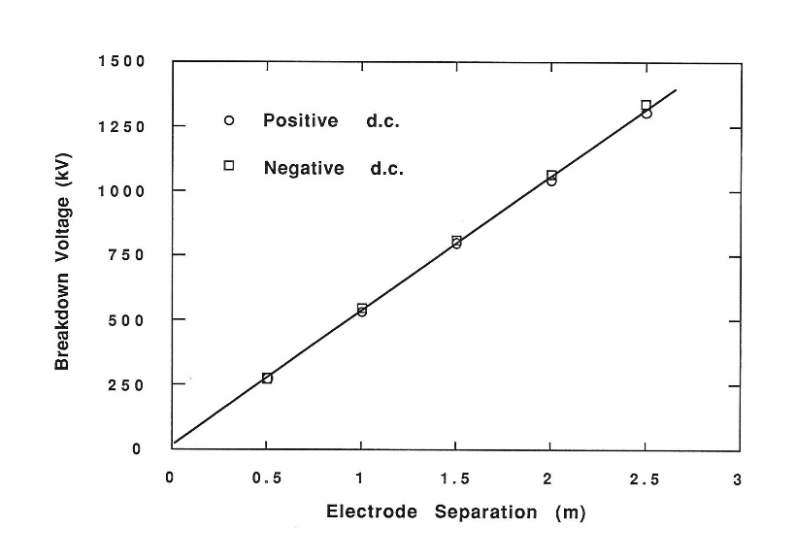
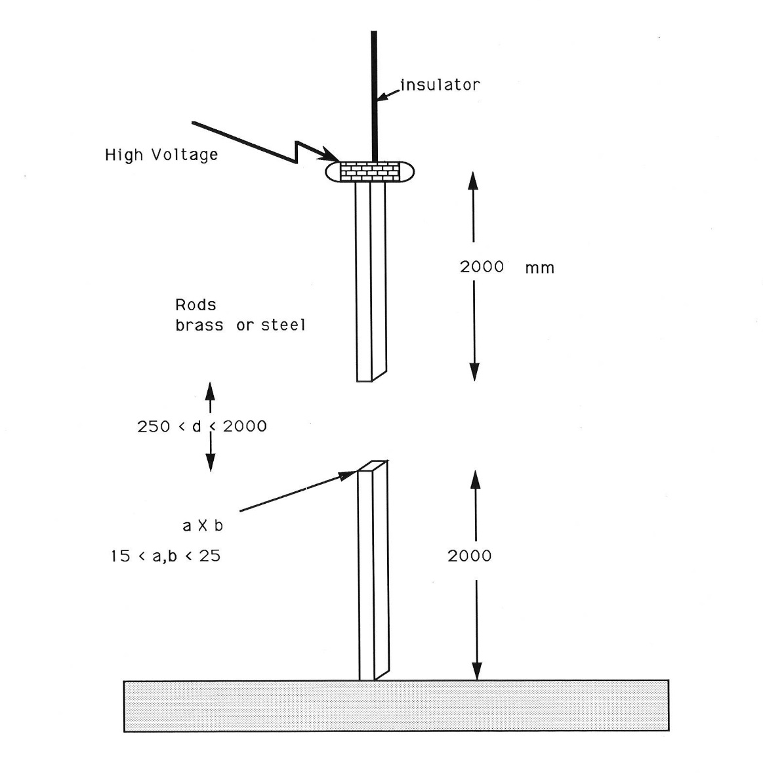
Singlet Delta Metastable Oxygen Molecules reduce sustaining field in air
from 25 kV/cm to 5 kV/cm
Feser and Hughes Electra 117, 23 (1988)
O₂(a¹Δ_{g}) + O₂⁻→ 2O₂ + e

